Slide 1
Cash Flow in Oracle EPM Cloud
It’s My Cash Flow and I Want it Now!
Notes:
Headshot, BPM overview, clients, - talk to Lee

Slide 2
Agenda
01
Introduction to Cash Flow Analysis
02
Cash Flow in Financial Consolidation and Close
03
Cash Flow in Planning
Cash Flow in Oracle EPM Cloud

Slide 3
About SC&H Group
OVERVIEW
Cash Flow in Oracle EPM Cloud

Slide 4
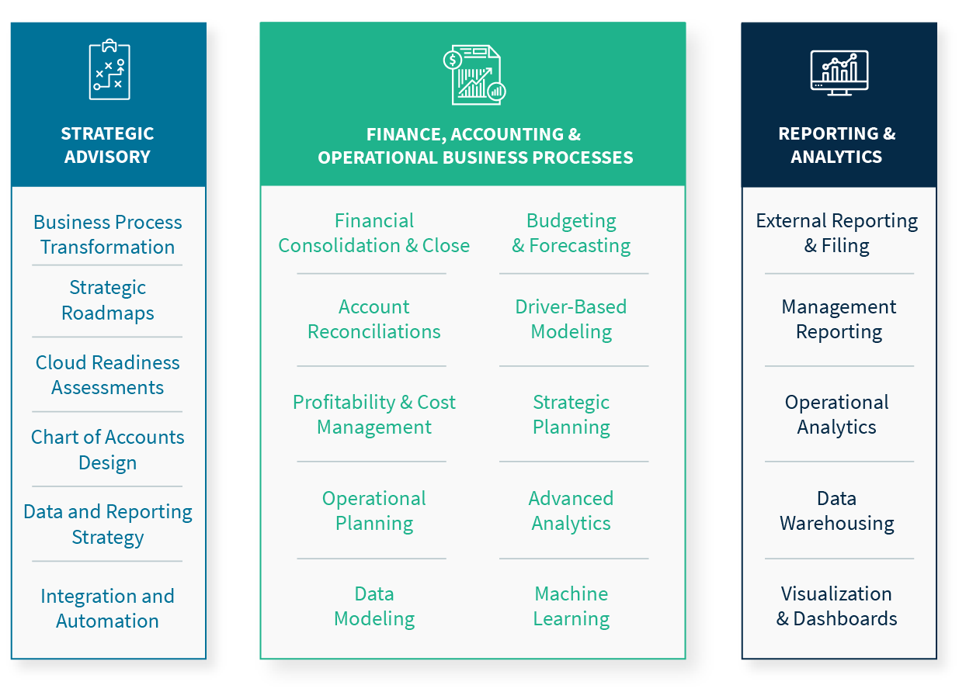
Core Capabilities
Cash Flow in Oracle EPM Cloud

Slide 5
Our Clients
PRACTICAL EXPERIENCE WITH 20-YEAR TRACK RECORD OF 100% SUCCESS
GOVERNMENT
CONTRACTING
HOSPITALITY/ RETAIL
MANUFACTURING
FINANCIAL SERVICES
OTHER
Cash Flow in Oracle EPM Cloud

Slide 6
Introduction to Cash Flow Analysis

Slide 7
What is Cash and How Does it Flow?
Cash includes any legal tender that can be used to exchange goods, debt, or services
Economic entities (individuals, companies, municipalities, etc.) require cash to support their activities
With cash, economic entities can:
Procure goods and services
Pay employees
Invest in key assets
Cover expenses like taxes, interest, and fees
In order to collect cash, economic entities can:
Sell goods and services
Collect taxes and fees
Secure debt or equity financing
Receive grants and other support payments
Cash Flow in Oracle EPM Cloud

Slide 8
Why Does Cash Flow Matter?
In order to remain solvent, economic entities must have enough cash to cover expenses, fees, and debt payments in a timely manner
Without cash, economic entities may default on debt, which leads to sever consequences
Without cash, economic entities may not be able to procure the resources required to successfully complete operations
Successful operations do not necessarily lead to successful cash flow management:
Revenues only generate cash when the buyer completes payment
Expenses can eat up cash long before they lead to revenue
Timing of debt payments and fees may not align with cash collections
Unsuccessful operations can still generate successful cash flow management
As long as an entity can find a way to collect cash, it can continue operations regardless of success or failure
Cash Flow in Oracle EPM Cloud

Slide 9
How Does Cash Flow Analysis Work?
The goal of cash flow analysis is to track cash inflows and outflows and project future cash movement
Cash flow analysis can include:
Tracking all cash transactions and classifying them by their nature and purpose
Tracking all business activities that use and generate cash, and deriving cash movements based on those findings
Reviewing outstanding receivables, payables, and unsold inventory to project timings for future cash collection
Projecting future activities that will impact cash requirements
Cash flow analysis can be maintained on a periodic basis or in real time, depending on operational needs
Businesses will often complete cash flow analysis as part of quarterly and annual planning activities
Cash flow analysis is required in most financial reporting
Rapid cash flow analysis can support significant opportunities for potential profitable investments
Cash Flow in Oracle EPM Cloud

Slide 10
How do Cash Flow Statements Work?
Cash flow statements organize cash flow analysis into a standardized reporting template
Cash flow statement templates allow uniform analysis across many entities
Cash flow statement templates vary slightly based on different reporting requirements (IFRS, GAAP, etc.)
Cash flow statements generally differentiate cash flows into the following types of activities:
Operating Activities: Cash inflows and outflows generated by regular business operations, such as sales, purchases, and SG&A expenses
Investing Activities: Cash inflows and outflows related to investments such as fixed assets, intangibles, and equity
Financing Activities: Cash inflows and outflows generated through financing such as creating debt, servicing loans, and paying dividends
Changes in Cash Related to FX: Changes in cash value related to fluctuations in exchange rates for foreign-currency holdings
Cash Flow in Oracle EPM Cloud

Slide 11
What are the Methods of Cash Flow Reporting?
Cash flow statements are generated using either the Direct Method or Indirect Method
Direct Method cash flow reporting differentiates activities based on actual cash transactions
For example, Cash Flow from Receivables is differentiated by tracking all receivables collected in the reporting period
This method requires careful data collection and tracking of individual transactions
Indirect Method cash flow reporting differentiates activities by deriving cash movements from balance sheet and P&L line items
For example, Cash Flow from Receivables is derived based on the periodic change in accounts receivable balance
This method relies on the completeness and accuracy of balance sheet and income statement reporting
This method is limited in cases where multiple types of activities are tracked in a single financial account, such as purchases and sales of fixed assets
Most entities prefer the Indirect Method for cash flow reporting
However, Indirect Method cash flow statements include Direct Method adjustments where account balances do not tell the full story
Cash Flow in Oracle EPM Cloud

Slide 12
Direct Method Cash Flow – Key Concepts
Direct Method cash flow reporting relies on accurate tracking of cash transactions
Cash flow statement line items are differentiated based on actual transactions:
Cash collected from customers
Wages paid
Cash paid to vendors
Income taxes paid
Because all cash transactions are clearly defined and differentiated on Direct Method reporting, FASB recommends companies use this method
Due to complexities in gathering and maintaining records for all cash transactions, most companies prefer Indirect Method reporting
Cash Flow in Oracle EPM Cloud

Slide 13
Indirect Method Cash Flow – Key Concepts
Indirect Method cash flow reporting uses changes in account balances to differentiate financial activities
Each financial account balance change must be used to generate cash flow line items:
Periodic change in accounts receivables define cash inflow/outflows from receivables
Periodic changes in dividends payable define cash outflows from dividends paid
Each Indirect Method statements starts with reported net income
First, reported income is adjusted to exclude non-cash revenues and expenses
This calculated cash income is combined with changes in short term assets and liabilities to define cash flow from operations
Because some P&L and balance sheet account movement can be generated by multiple types of transactions, Indirect Method statements rely on manual adjustments using actual cash transactions
Cash Flow in Oracle EPM Cloud

Slide 14
Other Key Cash Flow Metrics
In addition to the standard line items of cash flow from operating, investing, or financing activities, several other metrics are used in cash flow analysis
Free Cash Flow is the cash generated/spent to support operations and capital asset maintenance
This metric focuses on cash net income, changes in working capital balances, and capital expenditures
Investors often use this metric to project a business’s ability to support ongoing business activities
The Cash Conversion Cycle tracks the amount of time required to convert cash spending to generate goods into cash collected from customers
Days Payable Outstanding (DSO) calculates how long, on average, an entity takes to pay for inventory purchases
Days Inventory Outstanding (DIO) calculates how long, on average, an entity takes to convert inventory into revenue
Days Sales Outstanding (DSO) calculates how long, on average, an entity takes to collect cash for its sales
DIO + DSO combine to calculate how long it takes to convert inventory to cash
DIO + DSO – DPO combine to calculate how long it takes to convert cash payments for inventory into cash received for sales
Cash Flow in Oracle EPM Cloud

Slide 15
Cash Flow Models in EPM - Overview
Oracle EPM Cloud offers several options for cash flow analysis and reporting
Within Financial Consolidation and Close, cash flow reporting can be completed using standard system functionality combined with custom artifacts including:
Custom calculations to support Indirect Method complications such as add-backs to net income
Data entry forms to support manual adjustments to Indirect Method calculated results
Within Planning, cash flow analysis can be completed using:
Data inputs into forms
Data loads from external systems
Custom calculation scripts
Cash Flow in Oracle EPM Cloud

Slide 16
Cash Flow in Financial Consolidation and Close

Slide 17
Cash Flow in FCC – Dimensions
As part of default system functionality, Financial Consolidation and Close (FCC) natively supports cash flow analysis and reporting using the Movement dimension
This Movement dimension, in combination with the Account dimension, enables classification of all financial activities into financial line items and cash flow line items:
Account: Income statement and balance sheet reporting line; distinguishes the nature of financial activities
Movement: Cash flow reporting line; distinguishes the source of financial activities
Within the Movement dimension, there are 3 hierarchies that support cash flow creation:
FCCS_Movements: The main Movement hierarchy; traces activity from opening balance through closing balance
FCCS_CashFlow: Alternate hierarchy used for Cash Flow analysis and reporting; reframes movements as additions or subtractions from cash
FCCS_CashChange: Alternate hierarchy focused on cash balances; includes opening balance, fx impact, and closing balanace
Cash Flow in Oracle EPM Cloud

Slide 18
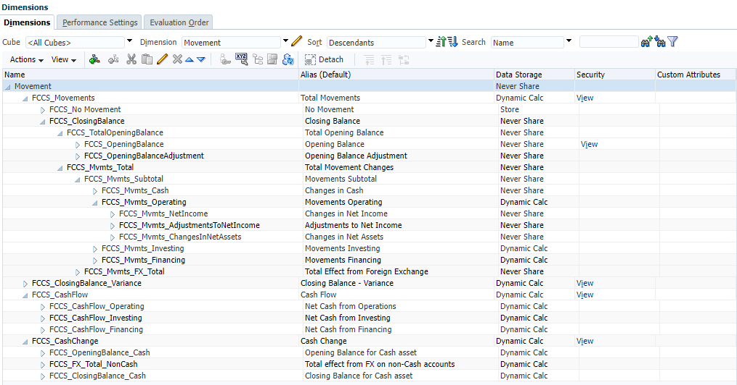
Cash Flow in FCC – Movement Dimension
Cash Flow in Oracle EPM Cloud

Slide 19
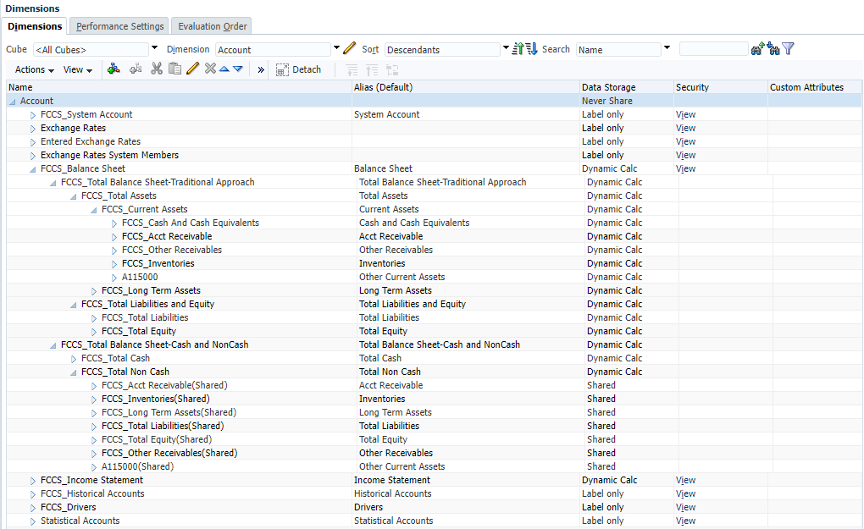
Cash Flow in FCC – Account Dimension
Cash Flow in Oracle EPM Cloud

Slide 20
Cash Flow in FCC – Data Creation
While loading data into FCC, users can create mappings to load data to default Movements
Generally, the Movement mappings are based on GL Account
Native Data Management functionality allows each line of data to map to only a single Movement member
Once data is loaded into FCC, calculations can be utilized to reclass certain cash flow data, where applicable
Generally, these calculations populate Net Income add-backs and their offsets in the Investing and Financing sections
These calculations can either be created as on-demand rules or as insertion rules to the consolidation process
Once system calculations are complete, users can also make manual reclass adjustments, where necessary
Generally, the Investing and Financing sections are most significantly populated using manual reclasses
These reclasses can be input using forms or ad hoc Smart View entries
Cash Flow in Oracle EPM Cloud

Slide 21
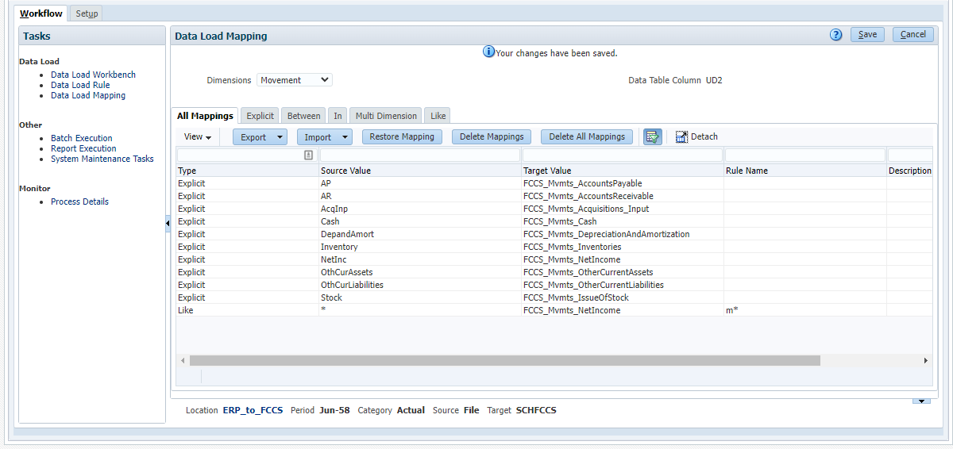
Cash Flow in FCC – Cash Flow Mappings
Cash Flow in Oracle EPM Cloud

Slide 22
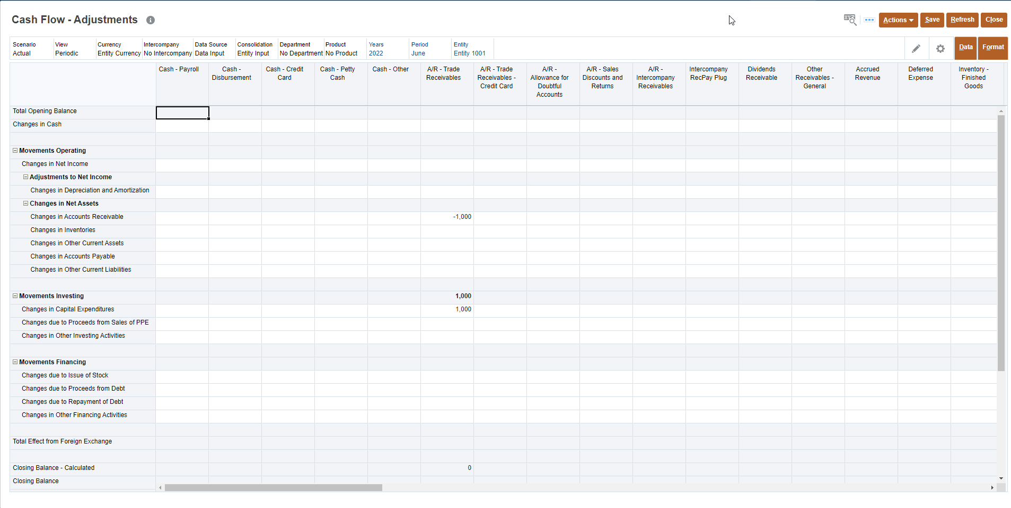
Cash Flow in FCC – Cash Flow Adjustment Forms
Cash Flow in Oracle EPM Cloud

Slide 23
Cash Flow in FCC – Cardinal Rules
1.
All monthly activity for each Account be mapped to a Movement
If an Account is not mapped to a Movement, the cash flow statement will not tie to actual change in cash
Total Movement activity for each Account should exactly match the true activity for that Account
Any adjustment between Movement line items must be offset with an equal and opposite adjustment
For example, if Depreciation Expense is moved to the Add Back Depreciation line, it must also be subtracted from the Changes in Fixed Assets line
Generally, each Account will populate an odd number of Movements (1, 3, 5, etc.)
Any Custom Movement members must be added to both the Total Movements hierarchy and the Cash Flow hierarchy
All non-cash Accounts must be included in the Total Non-Cash Account rollup
2.
3.
4.
Cash Flow in Oracle EPM Cloud

Slide 24
Cash Flow in FCC – Custom Calculation
Once base data is mapped into a default Movement, a custom cash flow calculation can be run to populate indirect method line items such as addbacks to net income
As discussed, each portion of the cash flow calculation must include both an adjustment and an offset to that adjustment
Within these rules, the general syntax is as follows
First, fix on the specific Accounts requiring cash flow line item adjustments
Next, copy the base data (usually at Net Income Movement) to the target Movement
Then, copy the same base data to an offset Movement
Ensure that either the adjustment or the offset are multiplied by -1 to ensure the net impact is $0
For performance reasons, we generally recommend running this rule on demand after each ERP load rather than as an insertion into the Consolidation process
This reduces Consolidation time when no changes are made to loaded data
Cash Flow in Oracle EPM Cloud

Slide 25
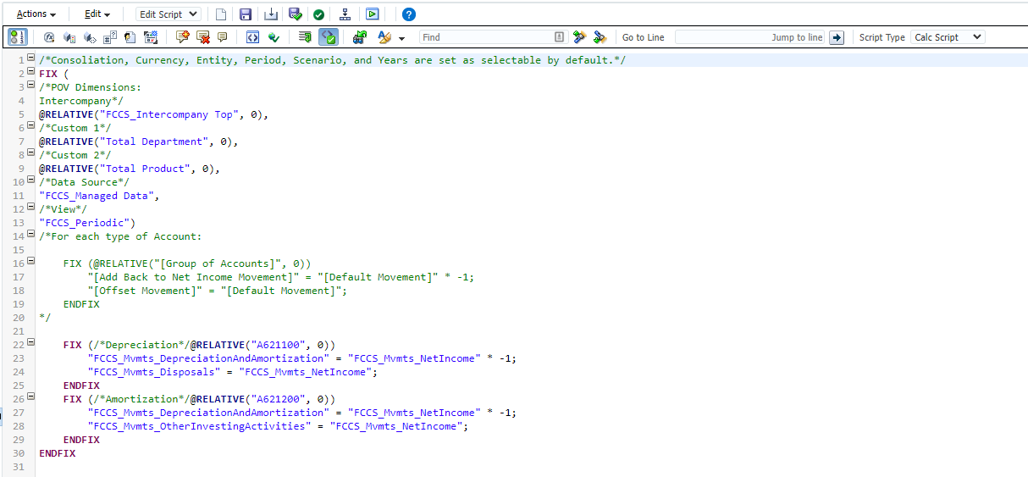
Cash Flow in FCC – Cash Flow Rules
Cash Flow in Oracle EPM Cloud

Slide 26
Cash Flow in FCC – Reporting
Once cash flow data is fully populated in the appropriate Movement members and the data is fully consolidated, cash flow reporting can be created using the various reporting capabilities within FCC and EPM Cloud
These cash flow reports will generally follow this template:
Fixed Point of View: Intercompany Top, Entity Total, Total Data Source, Total Custom Dimension(s)
Selectable Point of View: Scenario, Entity, Currency, Custom Dimension(s)
Columns: Years, Period
Rows:
Row | Account | Movement
Beginning Cash | Total Cash | Total Opening Balance
Cash Flow from Operations | Total Non-Cash | Cash Flow from Operations
Cash Flow from Investing | Total Non-Cash | Cash Flow from Investing
Cash Flow from Financing | Total Non-Cash | Cash Flow from Financing
FX Impacts on Cash | Total Non-Cash
Cash Flow in Oracle EPM Cloud

Slide 27
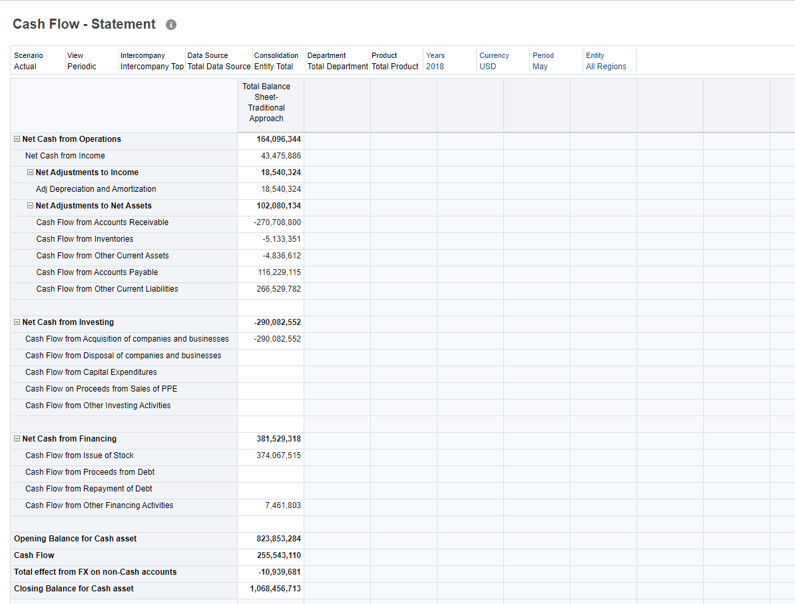
Cash Flow in FCC – Cash Flow Reporting
Cash Flow in Oracle EPM Cloud

Slide 28
Cash Flow in Planning

Slide 29
Cash Flow Models in Planning – Overview
In Planning (previously referred to as PBCS), there is no default Cash Flow functionality
All dimensions are configured at application creation
All artifacts are designed and created during the build process
This mirrors on-premise Hyperion Planning applications
Given this, one of several custom cash flow models must be designed and configured within a Planning application:
Manual Cash Flow: Users plan cash flow offline and submit cash flow line items directly via an input form in Planning
External Cash Flow : Users plan cash flow in an external system and load it via Data Management
Calculated Cash Flow – Account Model: Calculate cash flow within the Account dimension based on balance changes
Calculated Cash Flow – FCC Model: Calculate cash flow using a second dimension like the Movement dimension in FCC
In many cases, users will load actual cash flow data from FCC while planning budget cash flow using offline models
Cash Flow in Oracle EPM Cloud

Slide 30
Cash Flow in Planning – Manual
In a significant amount of companies, cash flow planning is handled offline by a small group of resources
Using primarily Excel, individuals or teams will use a formula-based approach to transform P&L and balance sheet data into a cash flow statement
Because the offline model is more familiar to users, companies will often maintain these models, even after implementing EPM systems
In these cases, some companies will load the outputs of these files into Planning as a direct submission, usually via data forms or Smart View submissions
Once the data is submitted at base intersections, standard Planning aggregations and currency conversions will be run to ensure that cash flow data is available at consolidated levels for reporting
Cash Flow in Oracle EPM Cloud

Slide 31
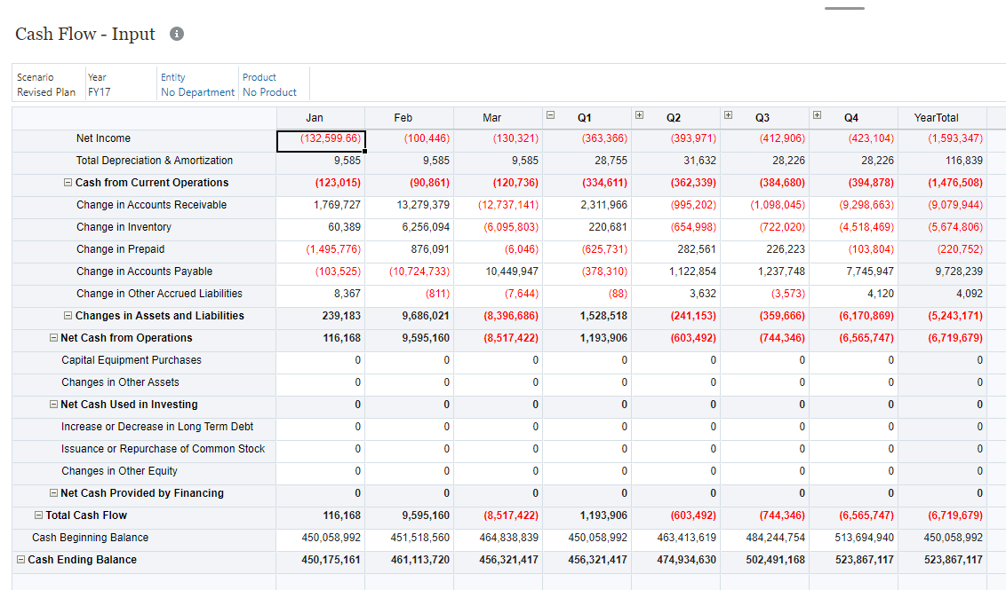
Cash Flow in Planning – Manual
Cash Flow in Oracle EPM Cloud

Slide 32
Cash Flow in Planning – External
In some cases, cash flow analysis will be initiated in external systems, such as an ERP or FCC application
Generally, these systems will calculate cash flow based on actual data
Occasionally, these systems may use driver-based growth models to project future cash flow
When cash flow data is loaded from these external systems, it can be loaded using Data Management
This load can be included with other data loaded from these systems, or as an additional load
Once the data load is completed, the cash flow data can flow through the same aggregation and conversion process as any other loaded data
In cases where external actual data is combined with manually planned budget data, data forms and reports can be used to generate comparison reporting
Cash Flow in Oracle EPM Cloud

Slide 33
Cash Flow in Planning – Custom Calculations
In Planning applications where both P&L and balance sheet activity is planned, custom calculations can be created to automatically generate cash flow modeling and reporting
These calculations can either occur within the Account dimension, or a second dimension like the FCCS Movement dimension
Method | Process | Benefits
Account-Based Model | Calculate cash flow data based on P&L and balance sheet activity and post the outcomes to cash flow Accounts | Simplifies dimensionality in Planning P&L, balance sheet, and cash flow reporting can all be generated using only the Account dimension
FCC Model | Assign a member in a second dimension (e.g. Nature, Data Type) to each account and run FCC-style rules to generate cash flow reporting | Aligns cash flow processes across EPM applications Greater transparency and support for calculated cash flow data
Cash Flow in Oracle EPM Cloud

Slide 34
Cash Flow in Planning – Account Model
In the Account-based model of cash flow in Planning, individual Accounts are created for each line item of the cash flow statement
Like other cash flow models, each P&L and balance sheet Account is assigned to a default cash flow Account
As part of the calculation, each cash flow Account will be set to the sum of all associated P&L and balance sheet Account movements
For example, “Changes in AR” will be set to the sum of balance changes in all AR accounts
Each Account, other than cash, should be included in this process
Where necessary, this calculation can also populate indirect method adjustments such as net income addbacks
The output of this calculation will support cash flow reporting, but it does not provide visibility into the supporting data for calculated results
Cash Flow in Oracle EPM Cloud

Slide 35
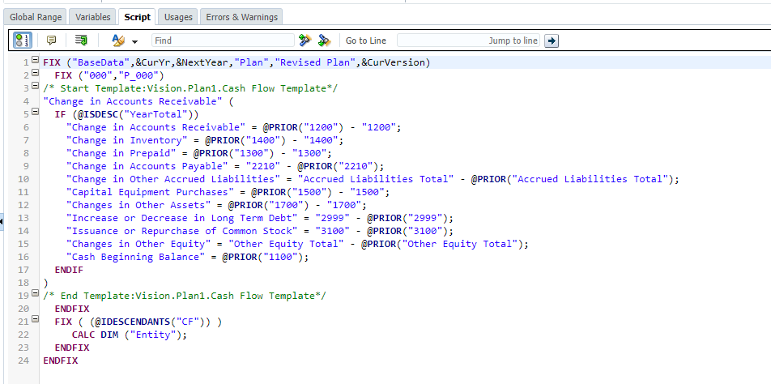
Cash Flow in Planning – Account Model
Cash Flow in Oracle EPM Cloud

Slide 36
Cash Flow in Planning – FCC Model
In the FCC model of cash flow in Planning, an additional dimension is used to track cash flow movements, mirroring the Movement dimension in FCC
In many cases, Planning applications will include a “Nature” or “Data Type” dimension which can be used to hold cash flow line items
If no such dimension exists, a new dimension could be created specifically for cash flow analysis and reporting
In these cases, the cash flow calculation will mirror the FCC calculation functionality
Note: Because FCC applications have unique dense/sparse dimension architecture, the actual calculation syntax will need to be adjusted
This cash flow calculation can be run as part of the normal consolidation and translation process, or as a one-off rule when cash flow reporting is required
FCC actual data can either be loaded directly to the cash flow members or calculated using the same process as plan data
Cash Flow in Oracle EPM Cloud

Slide 37
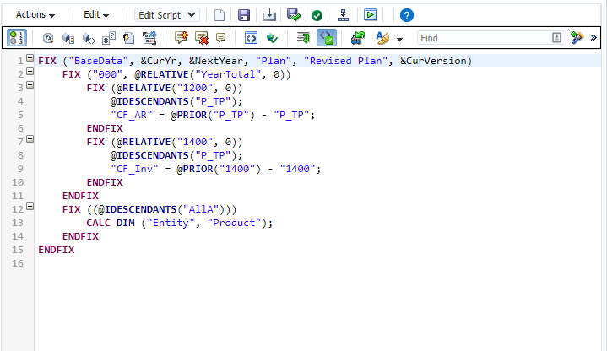
Cash Flow in Planning – FCC Model
Cash Flow in Oracle EPM Cloud

Slide 38
Get in Touch
POWERFUL MINDS
Ezra Fishman
Senior Manager
SC&H Group
efishman@schgroup.com
703-852-5620
Cash Flow in Oracle EPM Cloud

